Slide 1

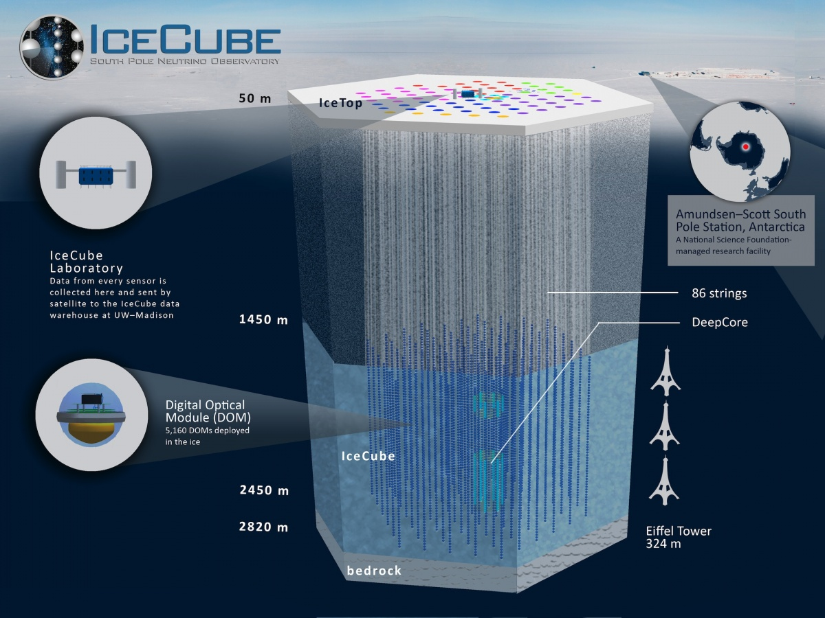
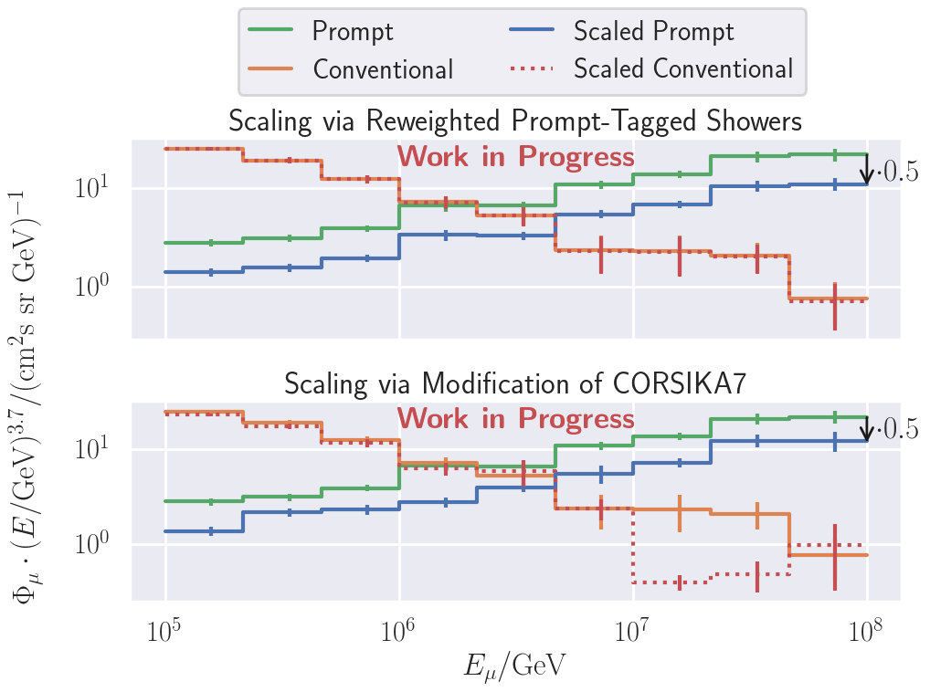
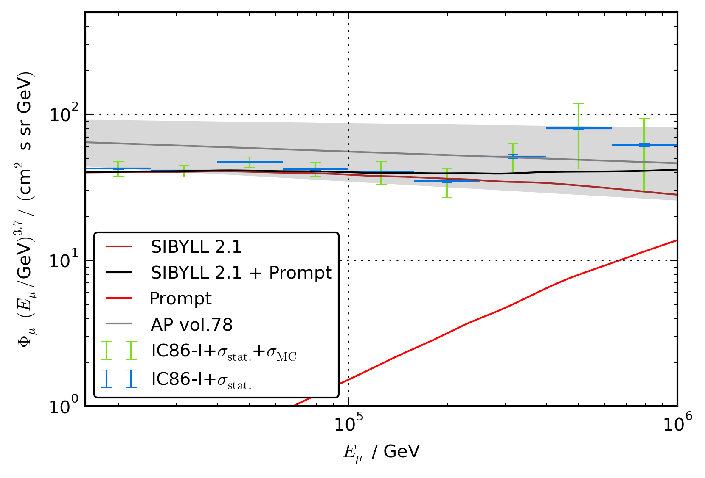
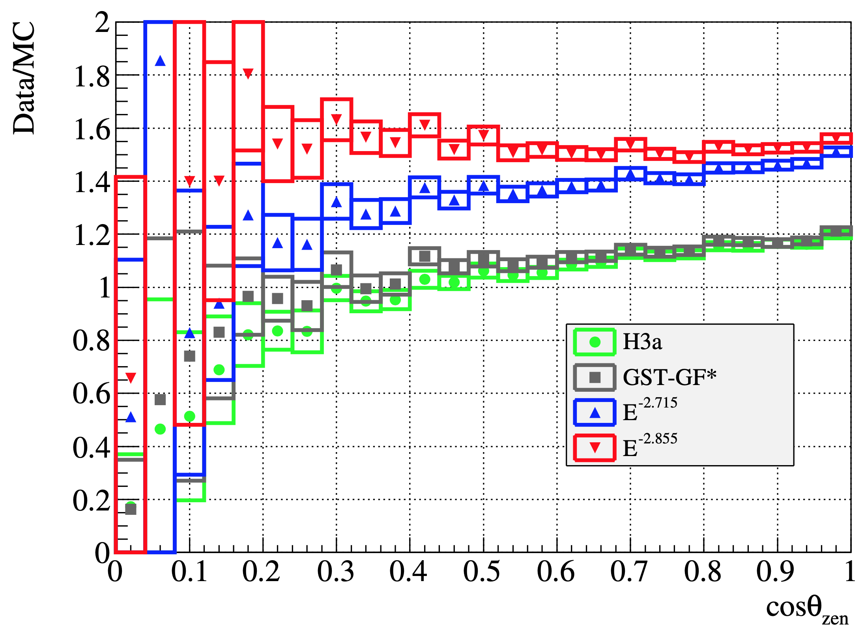
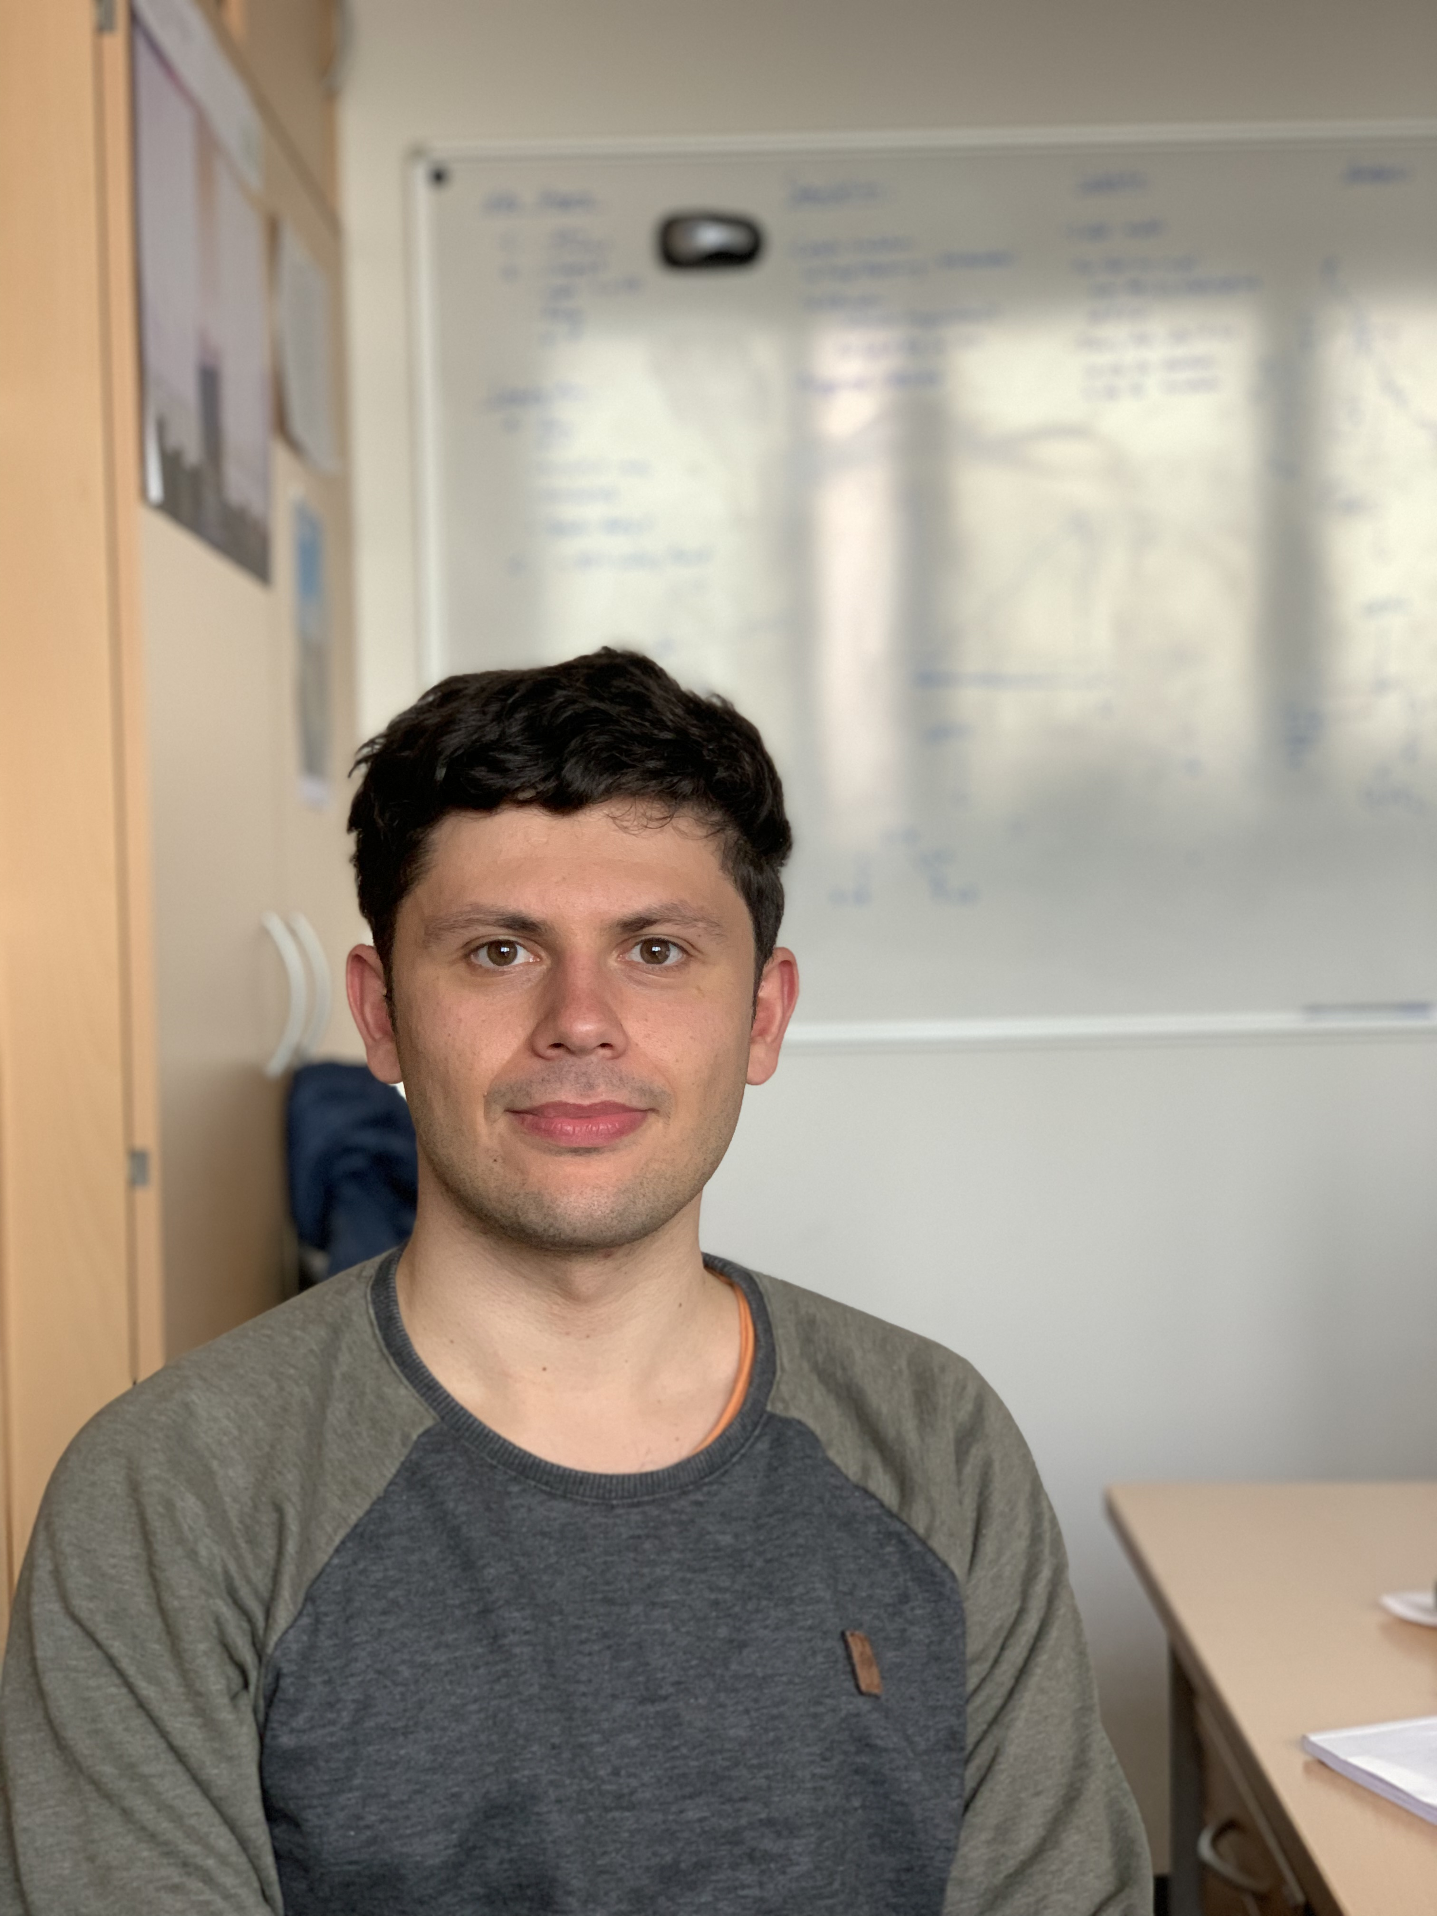
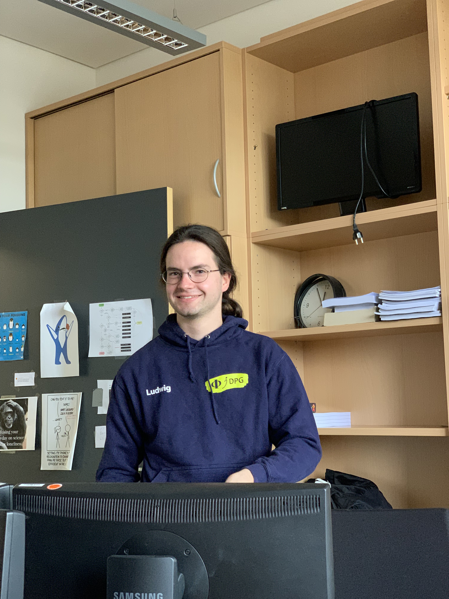



Ideas to measure the prompt component of the atmospheric muon flux
Jean-Marco Alameddine, Ludwig Neste and Pascal Gutjahr
Cosmic Rays in the Multi-Messenger Era Paris 2022
jean-marco.alameddine@tu-dortmund.de, ludwig.neste@tu-dortmund.de, pascal.gutjahr@tu-dortmund.de
The air shower simulation framework
CORSIKA 7 is used to estimate the muon flux at the earth surface. Since a large amount of
prompt muons arise due to charmed parent
particles, the module SIBYLL 2.3d is chosen
to simulate the hadronic interactions. It
includes the latest updates to simulate the
charm component.
To perform a fit of the normalization of the
prompt component, several CORSIKA
datasets should be created via re-weighting
the amount of prompt particles in the air
shower.
Cosmic rays interact with our atmosphere and
produce large air showers including several
types of stable and unstable particles. The
unstable daughter particles decay and muons
can be produced, which are able to reach the
surface of our earth. This atmospheric muon flux
is divided into a conventional and a prompt
component. Conventional muons come from
pions and kaons, which have a long lifetime
compared to the other particles that are defined as prompt. Due to the short lifetime of the prompt parent particles, they decay nearly instantly and do not loose any energy. This results in the fact,
that the prompt muon flux follows the primary
particle flux and dominates at energies higher
than TeV. A current challenge in this topic is the muon puzzle, that describes a mismatch
between the measured muon flux and the
simulated one.
In this analysis, new air shower simulations will
be performed with the latest CORSIKA version including hadronic interaction models describing
the charm component. With this, a new event
sample will be generated to measure the prompt muon flux with the IceCube Neutrino
Observatory.
Simulation
Introduction
masterclass.icecube.wisc.edu
$$Φ_{tot}= Φ_{conv}+ Φ_{prompt}$$
Atmospheric Muon Flux
Work in Progress
𝝿, 𝞙 ∝ E^{-3.7}
“rest” ∝ E^{-2.7}
(all particles with a decay length lower than 0.123 cm)
An analysis to measure the prompt components was done by T. Fuchs in [1]. The energy spectrum of leading muons with
E_{max} / E_{tot} > 0.5 was unfolded and a fit of the normalization was performed for several prompt models. Due to too less MC statistics, the factor describing the prompt
component is compatible with zero.
$$Φ\left(E\right)=N_{conv}∗Φ_{conv}(E)+N_{prompt}∗ Φ_{prompt}(E)$$
Another analysis was done in [2]. Hints of the
prompt muon flux are already presented,
but an unreasonable mismatch between
data and MC occurs in the cosine zenith
distribution. A constant offset of about
20 % more data is observed over the entire
range on trigger level. After applying quality
cuts, the ration diverges.
In both simulations, the hadronic interaction
model SIBYLL 2.1 was used which does not
consider charmed particles.
The simulation framework CORSIKA is used
to simulate 10 Mio. air shower for two
different injection angles 𝜃. Hadronic
interactions are modelled with SIBYLL 2.3d.
Protons are generated as primary particles
with energies from 10⁵ GeV to 10⁹ GeV using
a powerlaw of E⁻¹ reweighted to Gaisser H3a.
The results are compared to MCEq using
SIBYLL 2.3c for the prompt and conventional component. The deviations at energies
higher than 10⁷ GeV are caused by the
maximum injected energy lower than the
GZK cut off at ~5 * 10⁹ GeV. In CORSIKA, the
extended history option is used to identify
and tag the prompt particles manually.
A further comparison of the different prompt
particles between CORSIKA and SIBYLL 2.3c is performed. Mismatches occur for all the
D-mesons and these are still not solved.
The data of SIBYLL 2.3c are taken from [3].
Former Analyses
Work in Progress
Since the extended history option in CORSIKA may include some bugs, another cross-check to tag the prompt particles will be performed with DYNSTACK
New CORSIKA datasets with SIBYLL 2.3c/d will be simulated considering a charmed component and a tagging of prompt particles
Finally, an unfolding of the muon flux in energy/zenith bins and a fit of the normalization will be performed
Next Steps
References
[1] T. Fuchs, PhD Thesis, 10.17877/DE290R-17241
[2] Astropart. Phys. 78 (2016) 1-27
[3] Phys. Rev. D 100 (2019) 103018
Jean-Marco
Ludwig
Pascal
⋆ This work has been supported by the DFG, Collaborative Research Center SFB 876 (project C3) and Collaborative Research Center SFB 1491 (project F3) as well as by the BMBF, project 05A20PEA.
Notes:
Seitenlayout eingestellt auf Din A0: 84,1cm x 118,9cm

